Slide 1


Slide 2
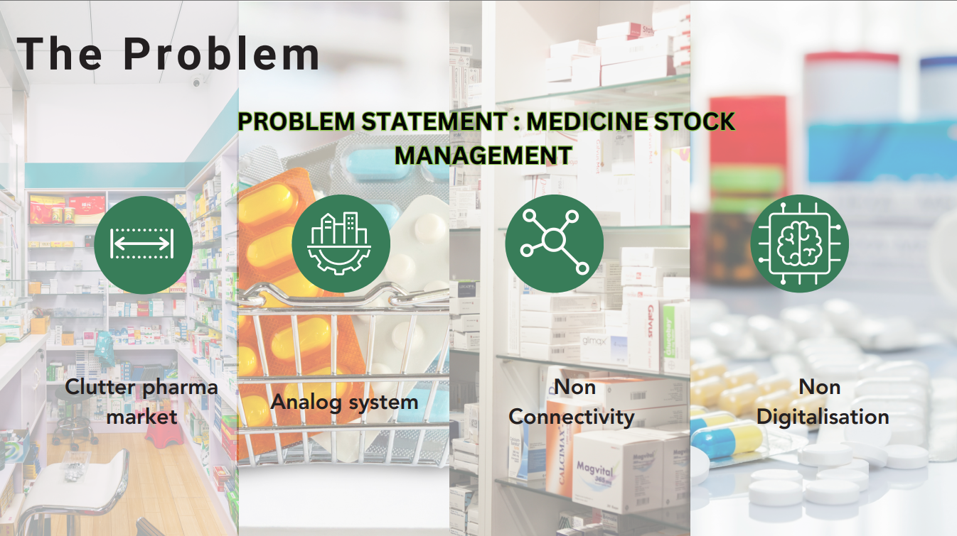

Slide 3
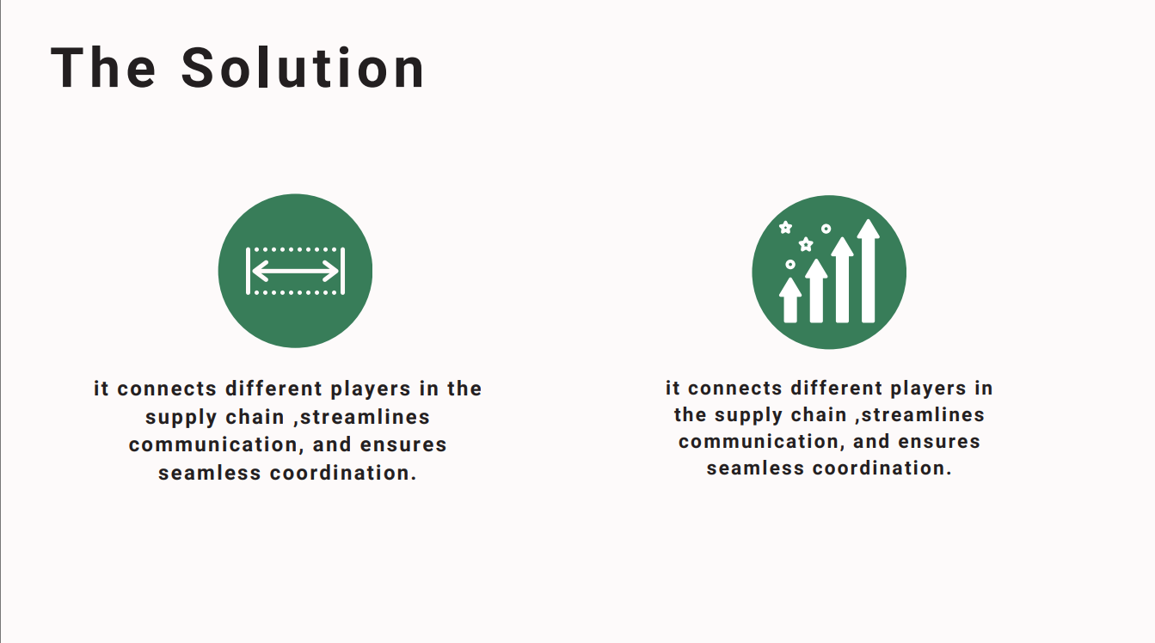

Slide 4
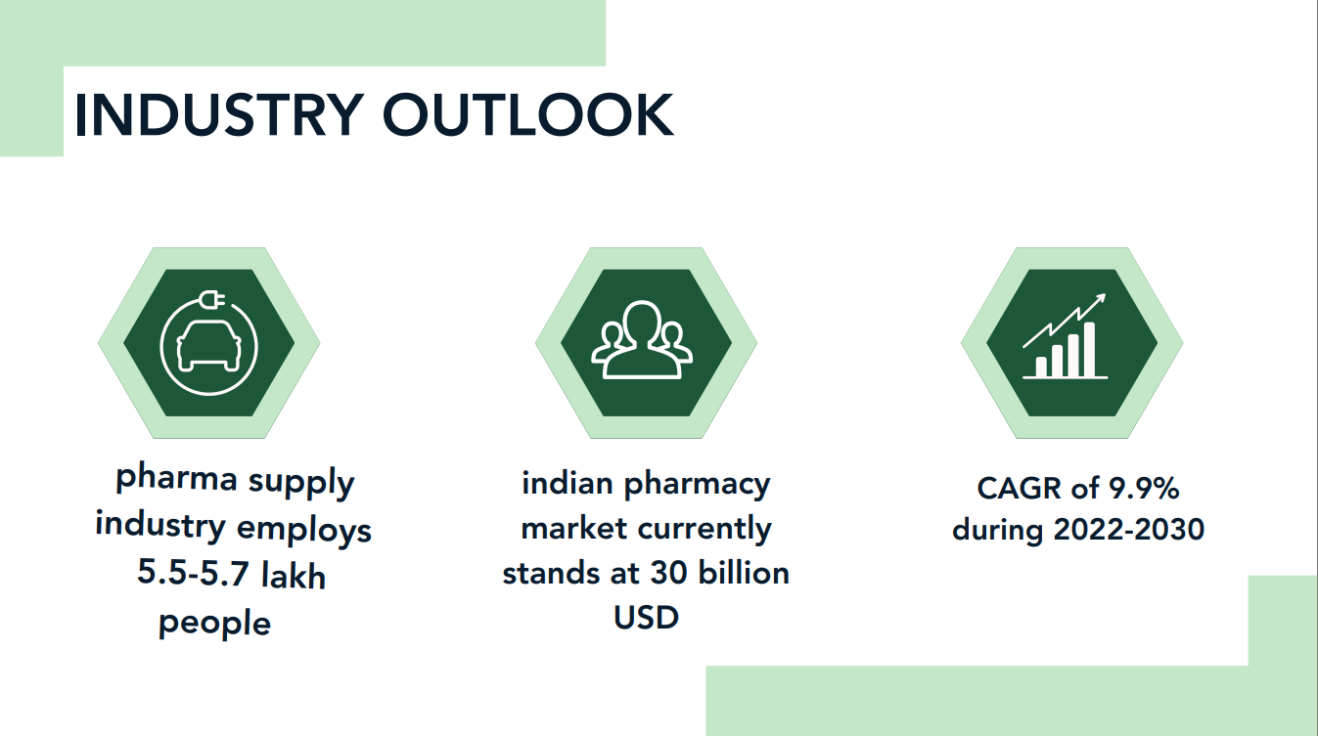


Slide 5
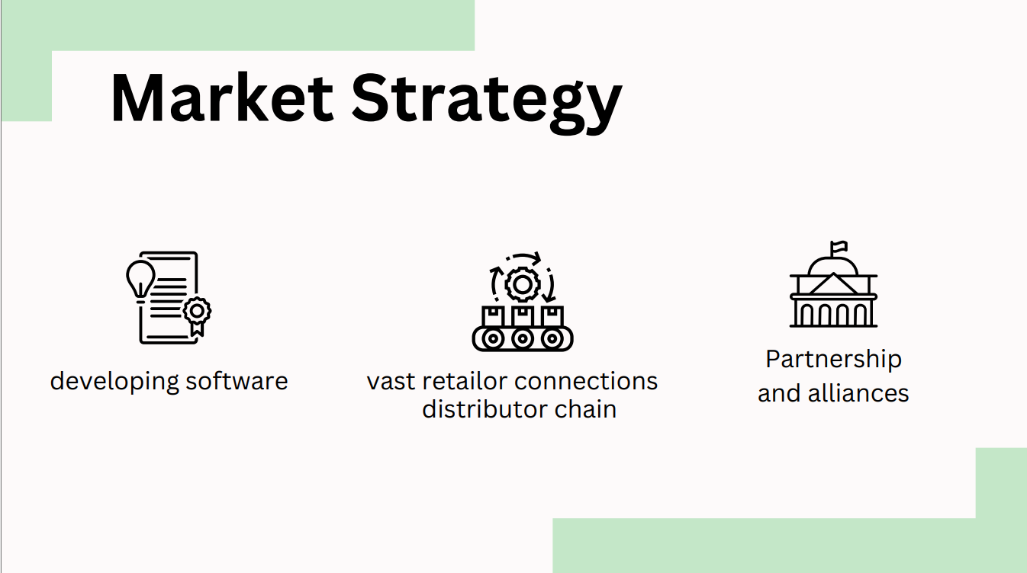

Slide 6
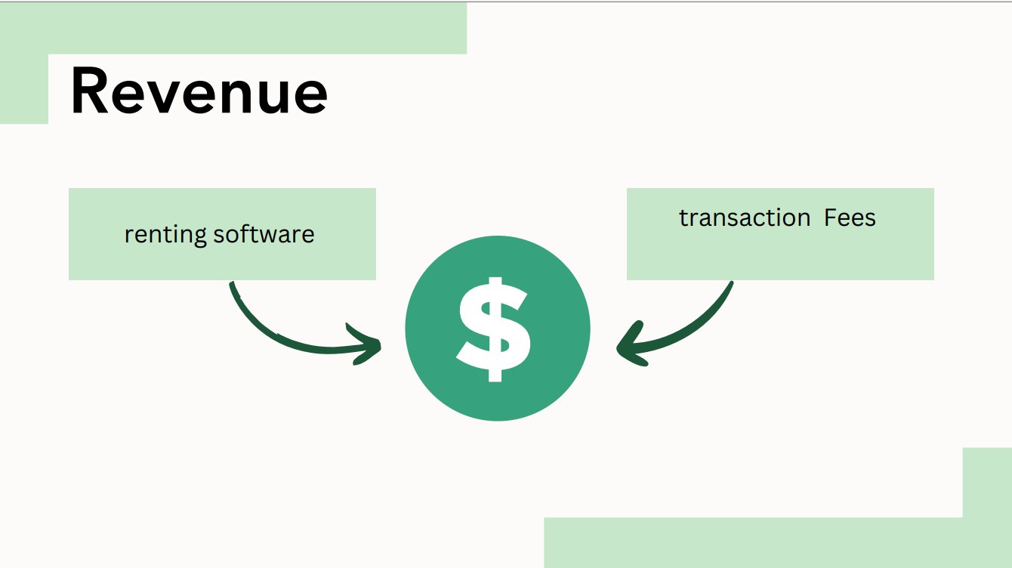
SUBCRIPTION MODEL
TRANSACTION FEES

Slide 7
TOOLS USED :
HTML,PYTHON,CSS AND SQL WE HAVE DEVELOPED A WEB APP AND DBMS THAT SMOOTHLY AND EFFICIENTLY CONNECT THE DIFFERENT STAGES OF SUPPLY CHAIN NETWORK.
THOUGHT PROCESS:
WE WANTED TO UNIFY THE DISCRETE SUPPLY CHAIN OF PHARMASUTICLES. WE WANTED TO REDUCE THE CHANCES OF STOCKOUT AND LOSSED OPPORTUNITY CHANCES. WE WANTED TO MITIGATE THE OFFLINE ORDER VERIFICATION SYSTEM CURRENTLY IN PLACE

Slide 8

REAL WORLD IMPACT
REPLACEMENT TO CURRENT OFFLINE BILLING SYSTEM
SEAMLESS CONNECTION BETWEEN CFA TO RETAILER IN THE SUPPLY CHAIN
AUTONOMOUS ORDERING OF MEDICINES
PREDICTION OF SEASONAL DISEASES AND EPIDEMICS AND PANDEMICS

Slide 9
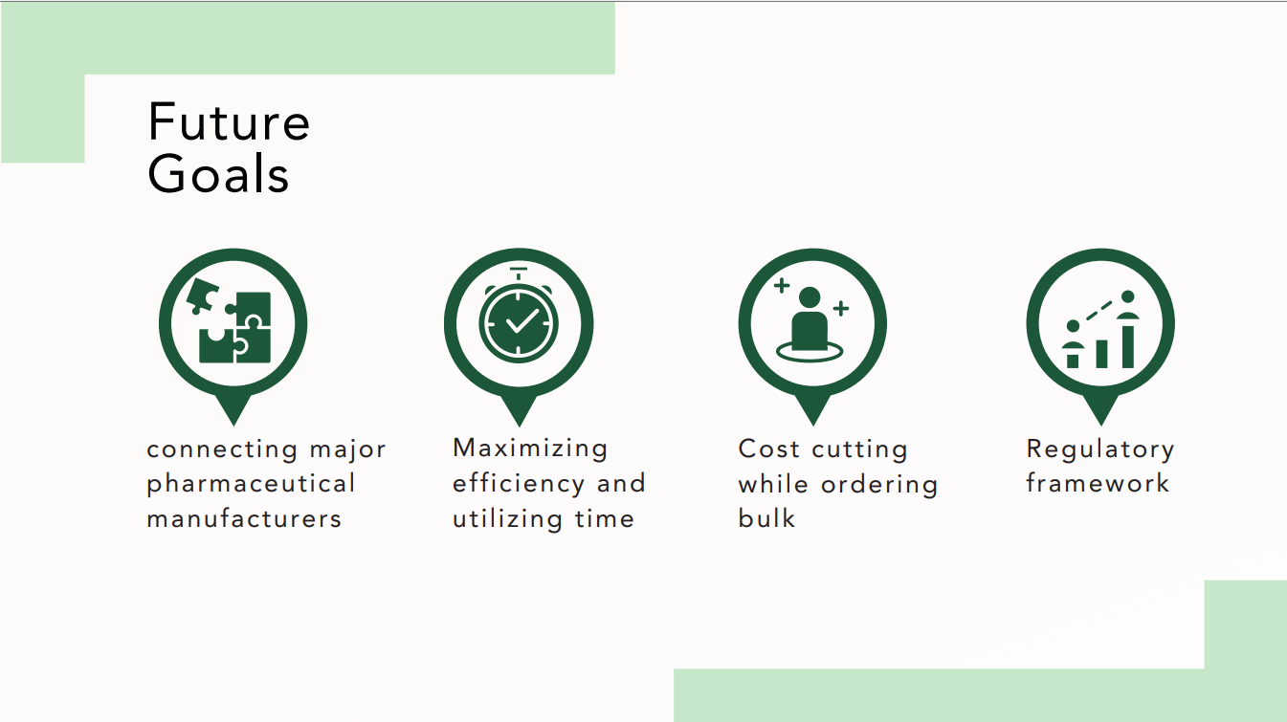

Slide 10
